Slide 1
GRAPHS
Swati Mali
swatimali@somaiya.edu

Slide 2
Outline
Graph- Concept
Graph terminology: vertex, edge, adjacent, incident, degree, cycle, path, connected component, spanning tree
Types of graphs: undirected, directed, weighted
Graph representations: adjacency matrix, array adjacency lists, linked adjacency lists
Graph search methods: breath-first, depth-first search

Slide 3
What is a graph?
A data structure that consists of a set of nodes (vertices) and a set of edges that relate the nodes to each other
The set of edges describes relationships among the vertices

Slide 4
Formal definition of graphs
A graph G is defined as follows:
G=(V,E)
V(G): a finite, nonempty set of vertices
E(G): a set of edges (pairs of vertices)
Vertices are also called nodes and points.
Each edge connects two vertices.
Edges are also called arcs and lines.
Vertices i and j are adjacent vertices iff (i, j) is an edge in the graph
The edge (i, j) is incident on the vertices i and j

Slide 5
Graphs
Undirected edge has no orientation (no arrow head)
Directed edge has an orientation (has an arrow head)
Undirected graph – all edges are undirected
Directed graph – all edges are directed
u
v
u
v
undirected edge
directed edge

Slide 6
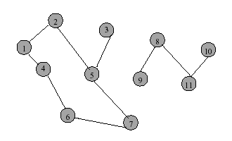
Undirected Graph

Slide 7
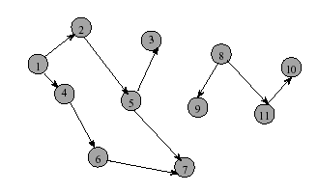
Directed Graph (Digraph)

Slide 8
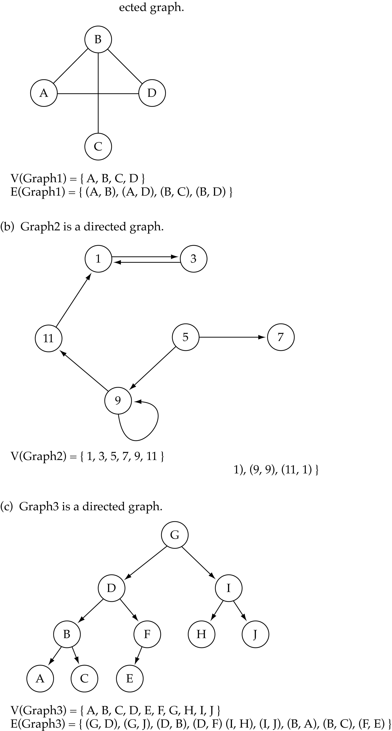
Directed vs. undirected graphs
When the edges in a graph have no direction, the graph is called undirected

Slide 9
Directed vs. undirected graphs (cont.)
When the edges in a graph have a direction, the graph is called directed (or digraph)
Warning: if the graph is directed, the order of the vertices in each edge is important !!
E(Graph2) = {(1,3) (3,1) (5,9) (9,11) (5,7)

Slide 10
Trees vs graphs
Trees are special cases of graphs!!

Slide 11
Graph terminology
Adjacent nodes: two nodes are adjacent if they are connected by an edge
Path: a sequence of vertices that connect two nodes in a graph
Complete graph: a graph in which every vertex is directly connected to every other vertex
5 is adjacent to 7
7 is adjacent from 55

Slide 12
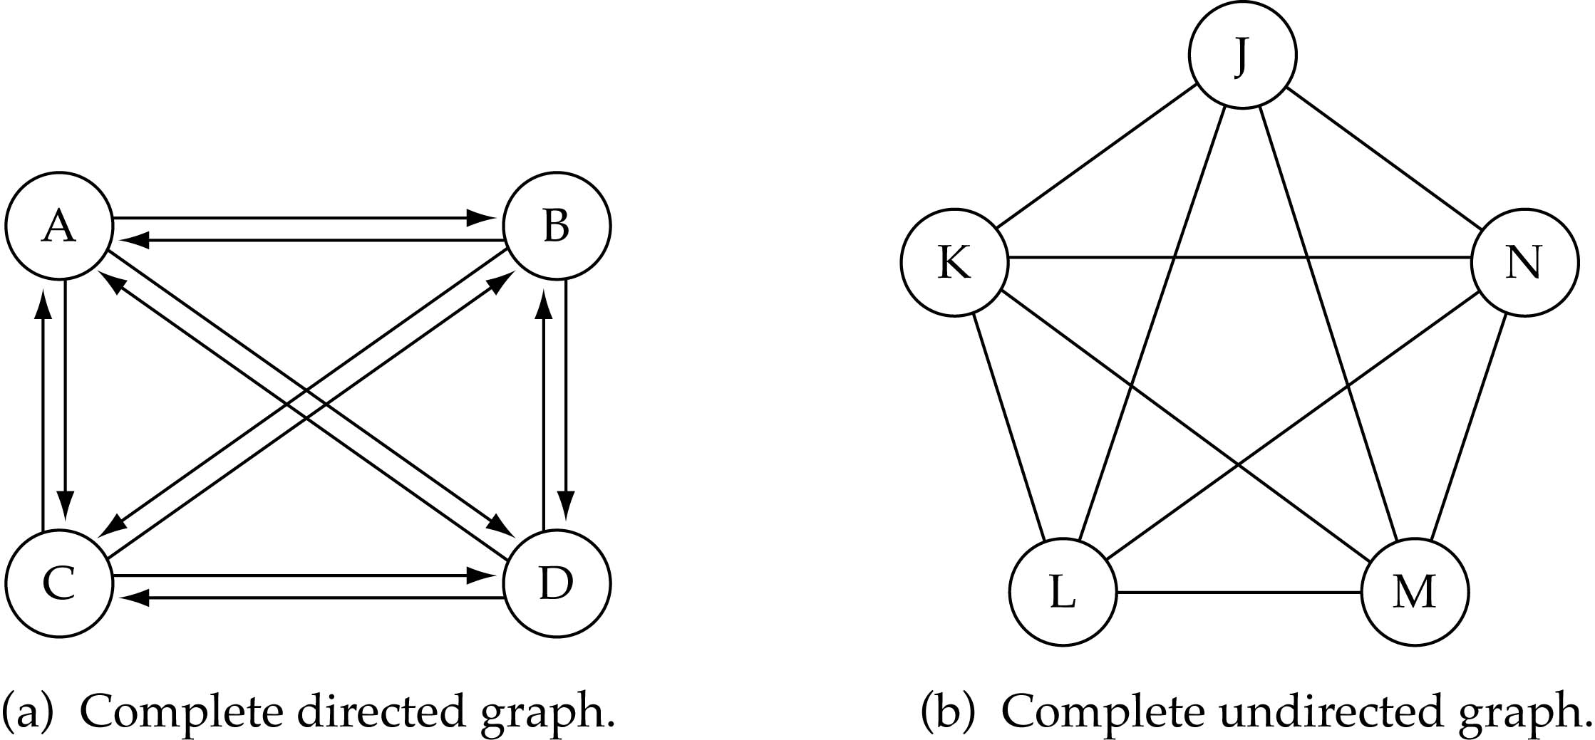
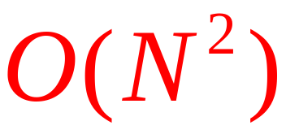
Graph terminology (cont.)
What is the number of edges in a complete directed graph with N vertices?
N * (N-1)

Slide 13
Graph terminology (cont.)
What is the number of edges in a complete undirected graph with N vertices?
N * (N-1) / 2

Slide 14
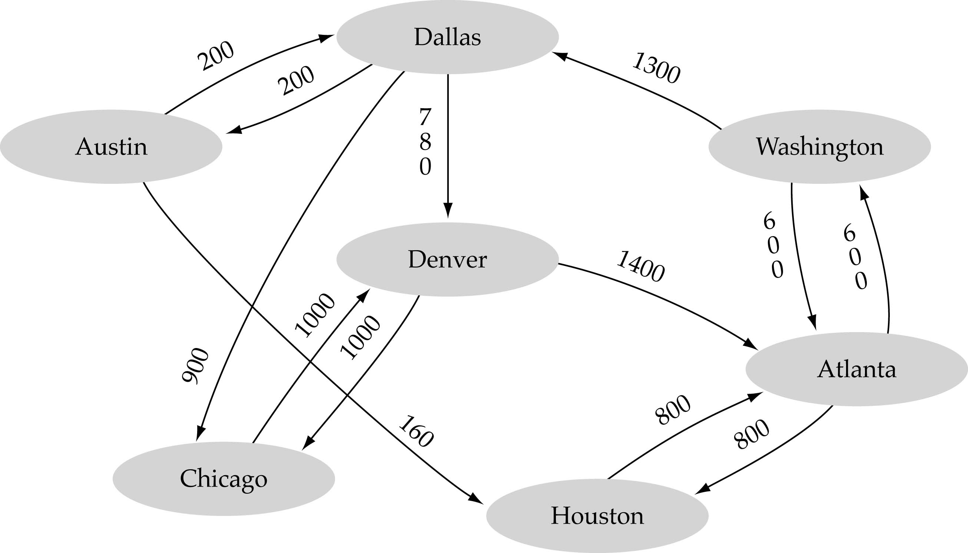
Graph terminology (cont.)
Weighted graph: a graph in which each edge carries a value

Slide 15
Applications – Communication Network
vertex = router
edge = communication link

Slide 16
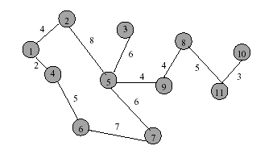
Applications - Driving Distance/Time Map
vertex = city
edge weight = driving distance/time

Slide 17
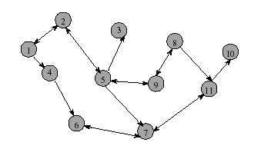
Applications - Street Map
Streets are one- or two-way.
A single directed edge denotes a one-way street
A two directed edge denotes a two-way street
Read Example 16.1 and see Figure 16.2

Slide 18
Path
A sequence of vertices P = i₁, i₂, …, i_{k} is an i₁ to i_{k} path in the graph G=(V, E) iff the edge (i_{j}, i_{j+1}) is in E for every j, 1≤ j < k
What are possible paths in Figure 16.2(b)?

Slide 19
Simple Path
A simple path is a path in which all vertices, except possibly in the first and last, are different

Slide 20
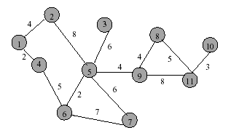
Length (Cost) of a Path
Each edge in a graph may have an associated length (or cost). The length of a path is the sum of the lengths of the edges on the path
What is the length of the path 5, 9, 11, 10?

Slide 21
Subgraph & Cycle
Let G = (V, E) be an undirected graph
A graph H is a subgraph of graph G iff its vertex and edge sets are subsets of those of G
A cycle is a simple path with the same start and end vertex
List all cycles of the graph of Figure 16.1(a)?
  1, 2, 3, 1
  1, 4, 3, 1
  1, 2, 3, 4, 1

Slide 22
Graph Properties

Slide 23
Number of Edges – Undirected Graph
Each edge is of the form (u,v), u != v.
The no. of possible pairs in an n vertex graph is n*(n-1)
Since edge (u,v) is the same as edge (v,u), the number of edges in an undirected graph is n*(n-1)/2
Thus, the number of edges in an undirected graph
is ≤ n*(n-1)/2

Slide 24
Number of Edges - Directed Graph
Each edge is of the form (u,v), u != v.
The no. of possible pairs in an n vertex graph is n*(n-1)
Since edge (u,v) is not the same as edge (v,u), the number of edges in a directed graph is n*(n-1)
Thus, the number of edges in a directed graph is ≤ n*(n-1)

Slide 25
Vertex Degree
The degree of vertex i is the no. of edges incident on vertex i.
e.g., degree(2) = 2, degree(5) = 3, degree(3) = 1

Slide 26

In-Degree of a Vertex
In-degree of vertex i is the number of edges incident to i (i.e., the number of incoming edges).
e.g., indegree(2) = 1, indegree(8) = 0

Slide 27
Out-Degree of a Vertex
Out-degree of vertex i is the number of edges incident from i
(i.e., the number of outgoing edges).
e.g., outdegree(2) = 1, outdegree(8) = 2

Slide 28
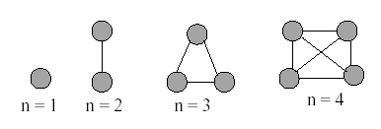
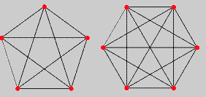
Complete Undirected Graphs
A complete undirected graph has n(n-1)/2 edges (i.e., all possible edges) and is denoted by K_{n}
What would a complete undirected graph look like when n=5? When n=6?

Slide 29
Connected Graph
Let G = (V, E) be an undirected graph
G is connected iff there is a path between every pair of vertices in G

Slide 30
Example of Not Connected

Slide 31
Example of Connected Graph

Slide 32
Representation of Unweighted Graphs
The most frequently used representations for unweighted graphs are
  Adjacency Matrix
  Linked adjacency lists
  Array adjacency lists

Slide 33
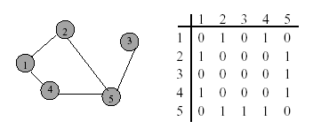
Adjacency Matrix
0/1 n x n matrix, where n = # of vertices
A(i, j) = 1 iff (i, j) is an edge.

Slide 34
Adjacency Matrix Properties
Diagonal entries are zero.
Adjacency matrix of an undirected graph is symmetric (A(i,j) = A(j,i) for all i and j).

Slide 35
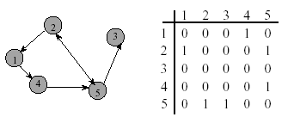
Adjacency Matrix for Digraph
Diagonal entries are zero.
Adjacency matrix of a digraph need not be symmetric.

Slide 36
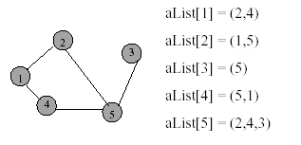
Adjacency Lists
Adjacency list for vertex i is a linear list of vertices adjacent from vertex i.
An array of n adjacency lists for each vertex of the graph.

Slide 37
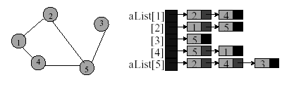
Linked Adjacency Lists
Each adjacency list is a chain.
Array length = n.
# of chain nodes = 2e (undirected graph)
# of chain nodes = e (digraph)

Slide 38
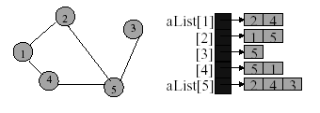
Array Adjacency Lists
Each adjacency list is an array list.
Array length = n.
# of chain nodes = 2e (undirected graph)
# of chain nodes = e (digraph)

Slide 39
Representation of Weighted Graphs
Weighted graphs are represented with simple extensions of those used for unweighted graphs
The cost-adjacency-matrix representation uses a matrix C just like the adjacency-matrix representation does
Cost-adjacency matrix: C(i, j) = cost of edge (i, j)
Adjacency lists: each list element is a pair
(adjacent vertex, edge weight)

Slide 40
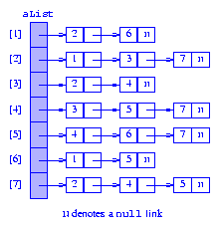
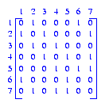
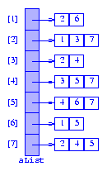
For the digraph Figure 16.2(b)
(a) adjacency matrix
(b) Linked adjacency list
(c) Array adjacency list

Slide 41
Graph Traversals (Search)
We have covered some of these with binary trees
  Breadth-first search (BFS)
  Depth-first search (DFS)
A traversal (search):
  An algorithm for systematically exploring a graph
  Visiting (all) vertices
  Until finding a goal vertex or until no more vertices
Only for connected graphs

Slide 42
Breadth-first search
One of the simplest algorithms
Also one of the most important
  It forms the basis for MANY graph algorithms

Slide 43
BFS: Level-by-level traversal
Given a starting vertex s
Visit all vertices at increasing distance from s
  Visit all vertices at distance k from s
  Then visit all vertices at distance k+1 from s
  Then ….

Slide 44
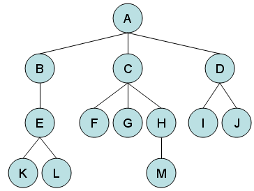
BFS in a tree
BFS: visit all siblings before their descendants
A B C D E F G H I J K L M

Slide 45
BFS: Graph
A
B
E
G
C
D
F
A B E G C D F

Slide 46
BFS(graph g, vertex s)
unmark all vertices in G
q ← new queue
mark s // s is starting vertex
enqueue(q, s)
while (not empty(q))
curr ← dequeue(q)
visit curr // e.g., print its data
for each edge <curr, V>
if V is unmarked
mark V
enqueue(q, V)

Slide 47
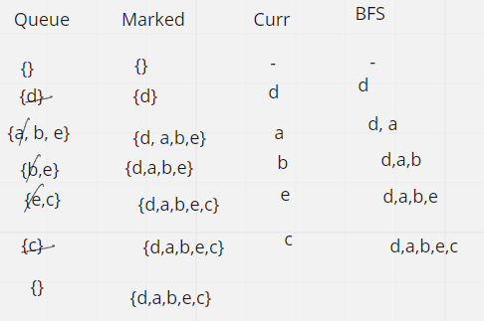
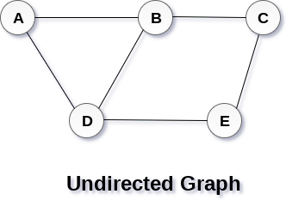
BFS algorithm
Starting vertex = d

Slide 48
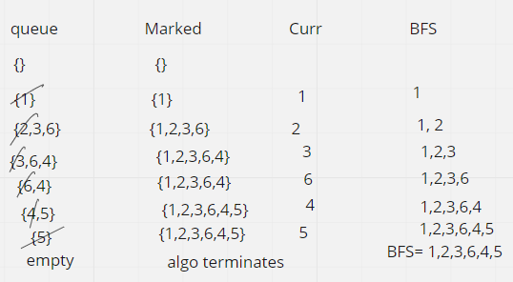
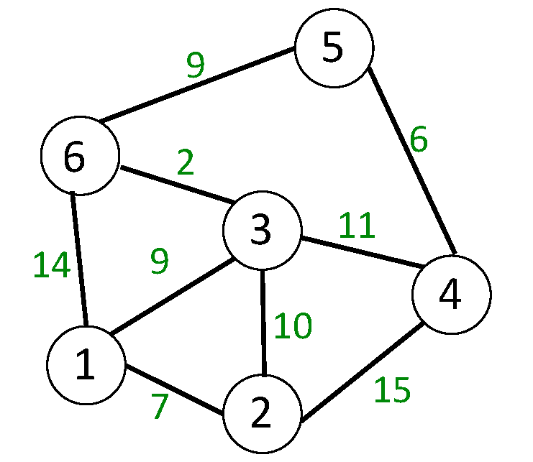

Slide 49
Interesting features of BFS
Complexity: O(|V| + |E|)
  All vertices put on queue exactly once
  For each vertex on queue, we expand its edges
  In other words, we traverse all edges once
BFS finds shortest path from s to each vertex
  Shortest in terms of number of edges
  Why does this work?
  Takes too much memory.
  Runs out of memory before it runs out of time.

Slide 50
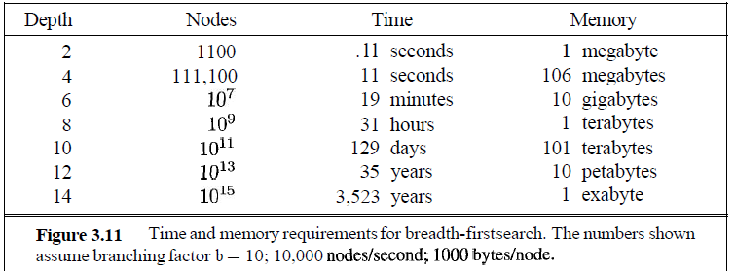
BFS- Time Complexity
Swati Mali

Slide 51
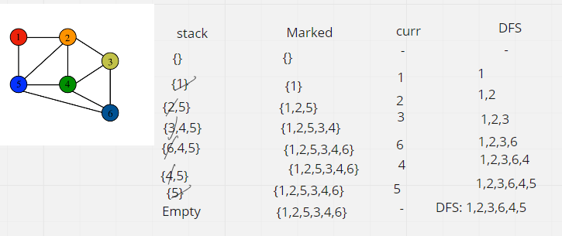


Slide 52
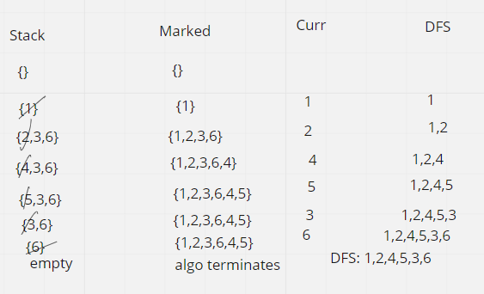

Slide 53
Depth-first search
Again, a simple and powerful algorithm
Given a starting vertex s
Pick an adjacent vertex, visit it.
  Then visit one of its adjacent vertices
  …..
  Until impossible, then backtrack, visit another

Slide 54
DFS(graph g, vertex s)
unmark all vertices in G
Stack ← new stack
mark s
Push(stack, s)
while (not empty(stack))
curr ← pop(stack)
visit curr // e.g., print its data
for each edge <curr, V>
if V is unmarked
mark V
push(stack, V)
  Print curr

Slide 55
Current vertex: A
A
B
E
G
C
D
F
Start with A. Mark it.

Slide 56
Current: B
A
B
E
G
C
D
F
Expand A’s adjacent vertices. Pick one (B).
Mark it and re-visit.

Slide 57
Current: C
A
B
E
G
C
D
F
Now expand B, and visit its neighbor, C.

Slide 58
Current: F
A
B
E
G
C
D
F
Visit F.
Pick one of its neighbors, E.

Slide 59
Current: E
A
B
E
G
C
D
F
E’s adjacent vertices are A, D and F.
A and F are marked, so pick D.

Slide 60
Current: D
A
B
E
G
C
D
F
Visit D. No new vertices available. Backtrack to
E. Backtrack to F. Backtrack to C. Backtrack to B

Slide 61
Current: G
A
B
E
G
C
D
F
Visit G. No new vertices from here. Backtrack to
B. Backtrack to A. E already marked so no new.

Slide 62
Current:
1
A
2
5
B
E
6
3
7
C
D
G
4
F
Done. We have explored the graph in order:
A B C F E D G

Slide 63
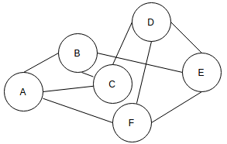
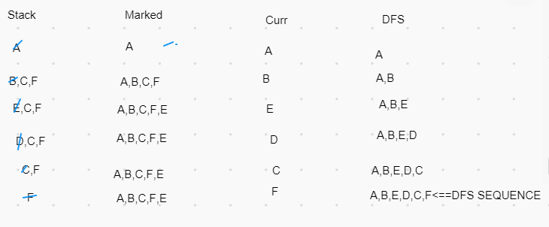
Method 1

Slide 64
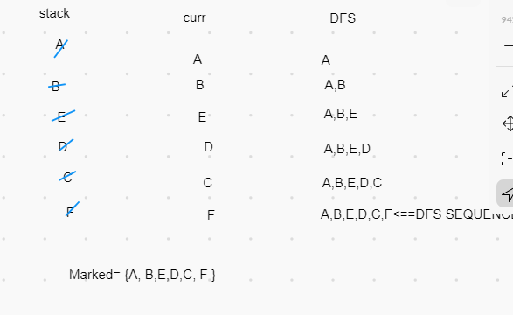
Method 2

Slide 65
Interesting features of DFS
Complexity: O(|V| + |E|)
  All vertices visited once, then marked
  For each vertex on stack, we examine all edges
  In other words, we traverse all edges once
DFS does not necessarily find shortest path
  Why?
Not a good choice when the goal node is at shallow level on right side of the graph

Slide 66
QUERIES?

Slide 67
THANK YOU

